Slide 1
IE 411/511:
Visual Programming for Industrial Applications
Lecture Notes #7
Arrays

Slide 2
Module Learning Objectives
In this module you will learn:
To declare, initialize, and refer to elements of arrays
  One-dimensional arrays
  Two-dimensional arrays
To use the For Each…Next statement to iterate through all the elements of an array
To change the size of an array

Slide 3
Introduction
An array is a group of variables
  Array variables are called elements
  All elements in an array have the same type (e.g., Integer)
To refer to a particular element, we specify
  The name of the array, and
  The position number (i.e., the index) of the element to which we refer
All arrays are objects of class System.Array
  Arrays inherit all the methods and properties from this class
  msdn.microsoft.com/library/system.array

Slide 4
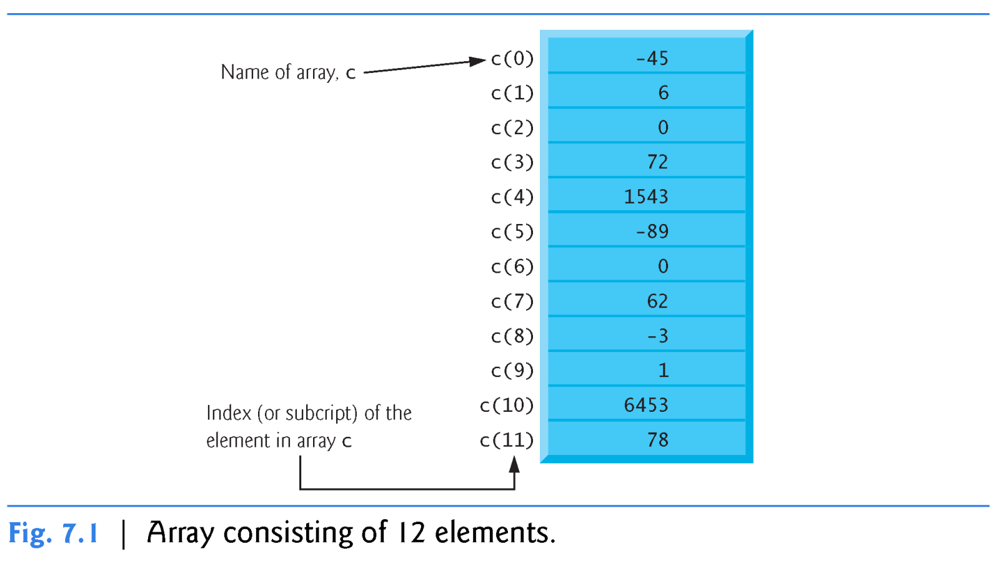
Arrays
Example of an Array

Slide 5
Arrays (cont.)
Accessing Array Elements
The position number in parentheses is called an index
  Must be a nonnegative integer or an integer expression
  If an expression is used as the index, the expression is evaluated first to determine the index
For example, if variable value1 is equal to 5 and variable value2 is equal to 6, then the statement
  c(value1 + value2) += 2 adds 2 to array element c(11)

Slide 6
Arrays (cont.)
Values stored in arrays can be used in calculations
  sum = c(0) + c(1) + c(2)
  result = c(6) \ 2
Every array “knows” its own length (i.e., the number of elements it contains)
  It is determined by the array’s Length property
    c.Length

Slide 7
Declaring and Allocating Arrays
The following statement can be used to declare array c
Dim c(11) As Integer
The parentheses that follow the variable name indicate that c is an array
Arrays can be declared to contain elements of any type
  However, every element of the array must be of the same type
The number in parentheses in the array declaration helps the compiler allocate memory for the array c

Slide 8
Declaring and Allocating Arrays (cont.)
In the preceding declaration, the number 11 defines the array’s upper bound
  Array bounds determine what indices can be used to access an element in the array
  Here the array bounds are 0 and 11
The bound 0 is implicit in the preceding statement and is always the lower bound of every array
An index outside these bounds cannot be used to access elements in the array c
  Otherwise, an exception is thrown

Slide 9
Declaring and Allocating Arrays (cont.)
We can also explicitly specify the array bounds
Dim c(0 To 11) As Integer
The explicit array bounds indicate that the lower bound of the array is 0 and the upper bound is 11
  The size of the array is still 12
In this module, it is assumed that the lower bound of an array is always 0

Slide 10
Declaring and Allocating Arrays (cont.)
Initializer Lists
You can follow an array declaration with an equal sign and an initializer list in braces (i.e., { }) to specify the initial values of the array’s elements
Dim numbers() As Integer = {1, 2, 3, 6}
The compiler determines the array bounds from the number of elements in the initializer list
  You cannot specify the upper bound of the array when an initializer list is present

Slide 11
Declaring and Allocating Arrays (cont.)
Initializer Lists
You can also use local type inference to determine an array’s type from an initializer list
So, the preceding declaration can be written as
Dim numbers = {1, 2, 3, 6}
When you do not provide an initializer list, the elements in the array are initialized to the default value for the array’s type
  0 for numeric primitive data-type variables; False for Boolean variables; and Nothing for String and other class types

Slide 12
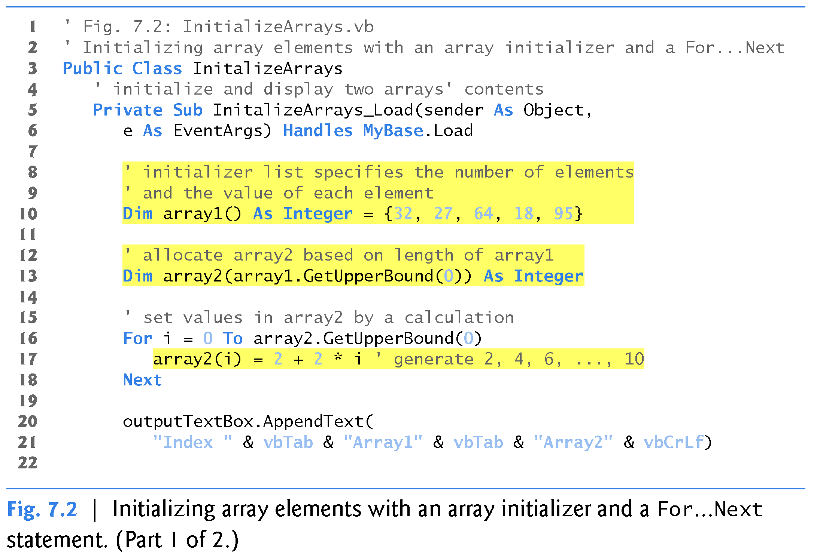
Declaring and Allocating Arrays (cont.)

Slide 13
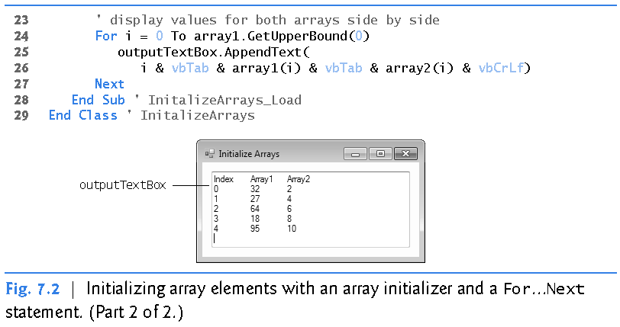
Declaring and Allocating Arrays (cont.)

Slide 14
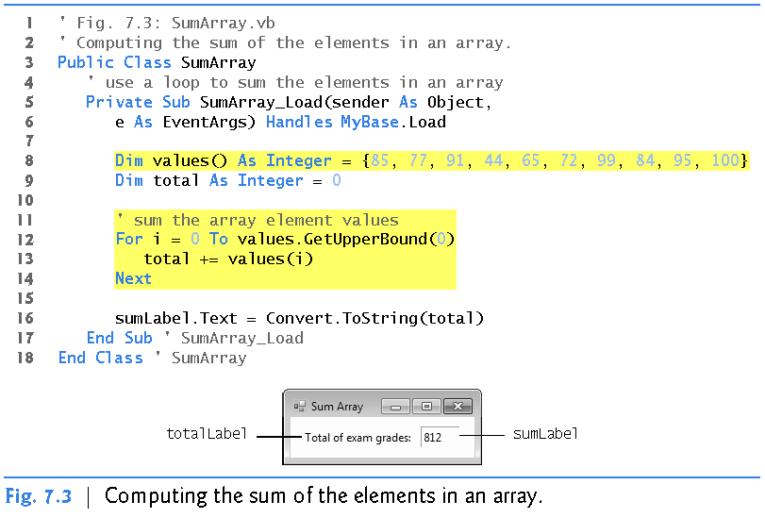
Calculations with Arrays
Adding the Elements of an Array

Slide 15
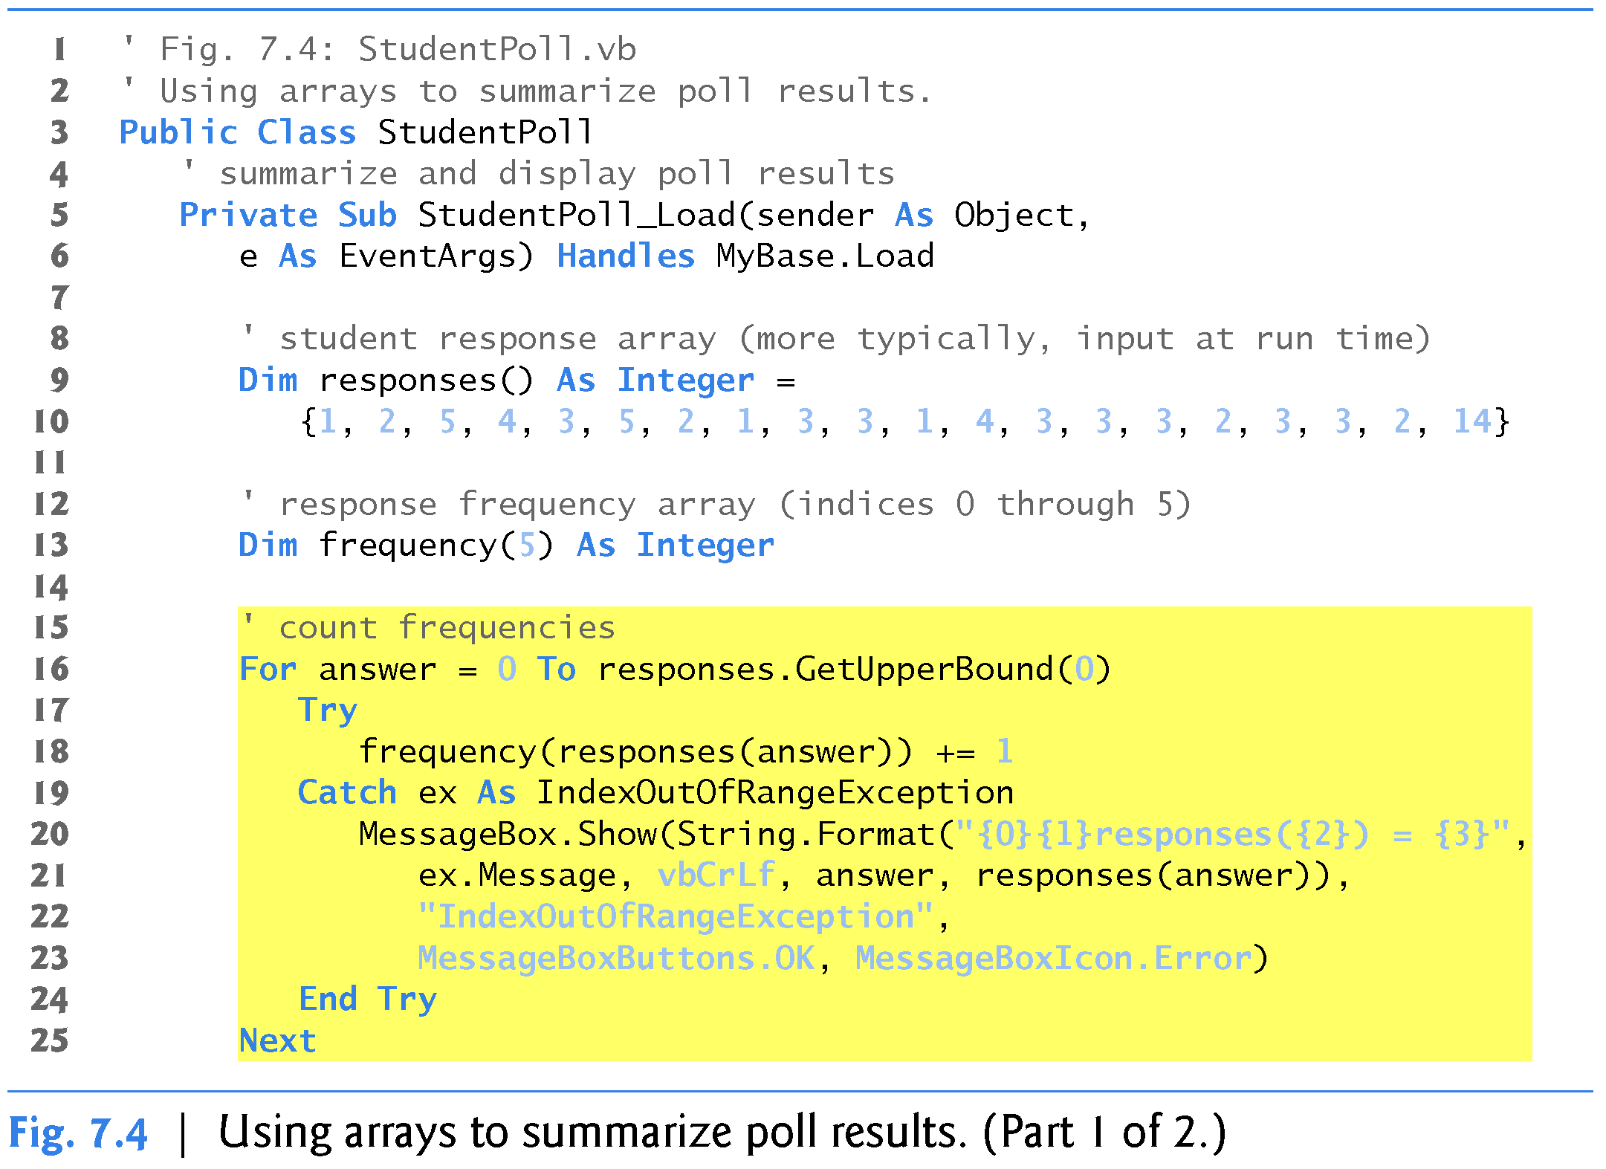
Calculations with Arrays (cont.)
Using Arrays to Summarize Data

Slide 16
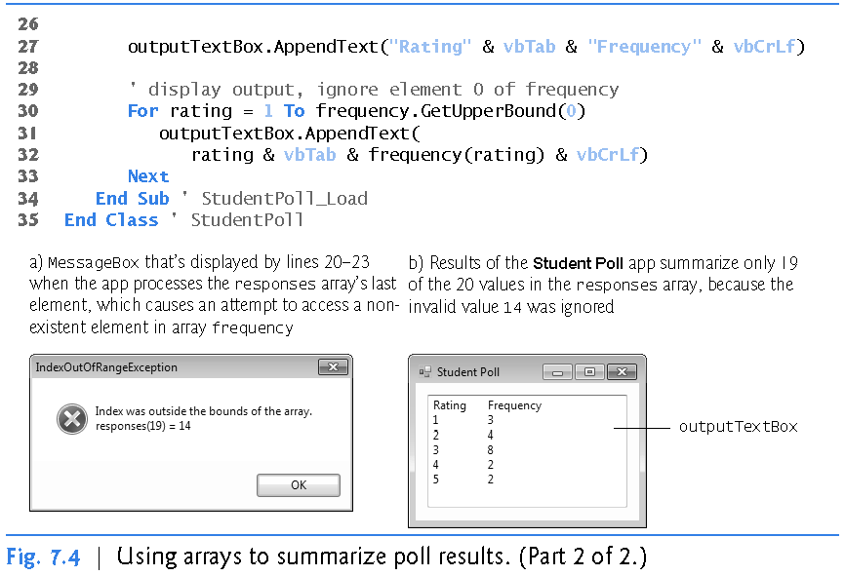
Calculations with Arrays (cont.)
Using Arrays to Summarize Data

Slide 17
For Each…Next Statement
The For Each…Next repetition statement iterates through the values in a data structure (such as an array) without using a loop counter
The repetition of the For Each…Next statement begins with the element whose index is zero, iterating through all the elements
Instead of a counter, For Each…Next uses a variable to represent the value of each element

Slide 18
For Each…Next Statement (cont.)
For Each…Next behaves like a For…Next statement that iterates through the range of indices from 0 to the value returned by GetUpperBound(0)
Although many array calculations are handled best with a counter, For Each…Next is useful when
  You wish to process all the elements of an array, and
  Do not need to access the index values in the loop’s body

Slide 19
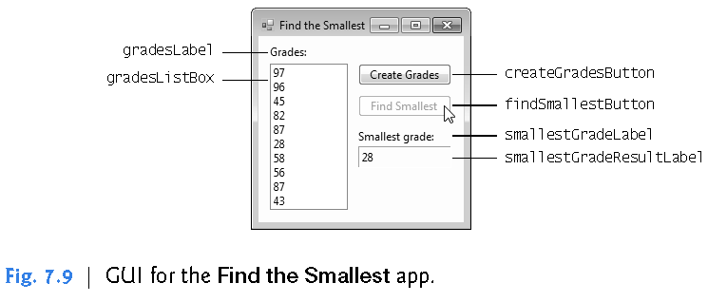
For Each…Next Statement (cont.)

Slide 20
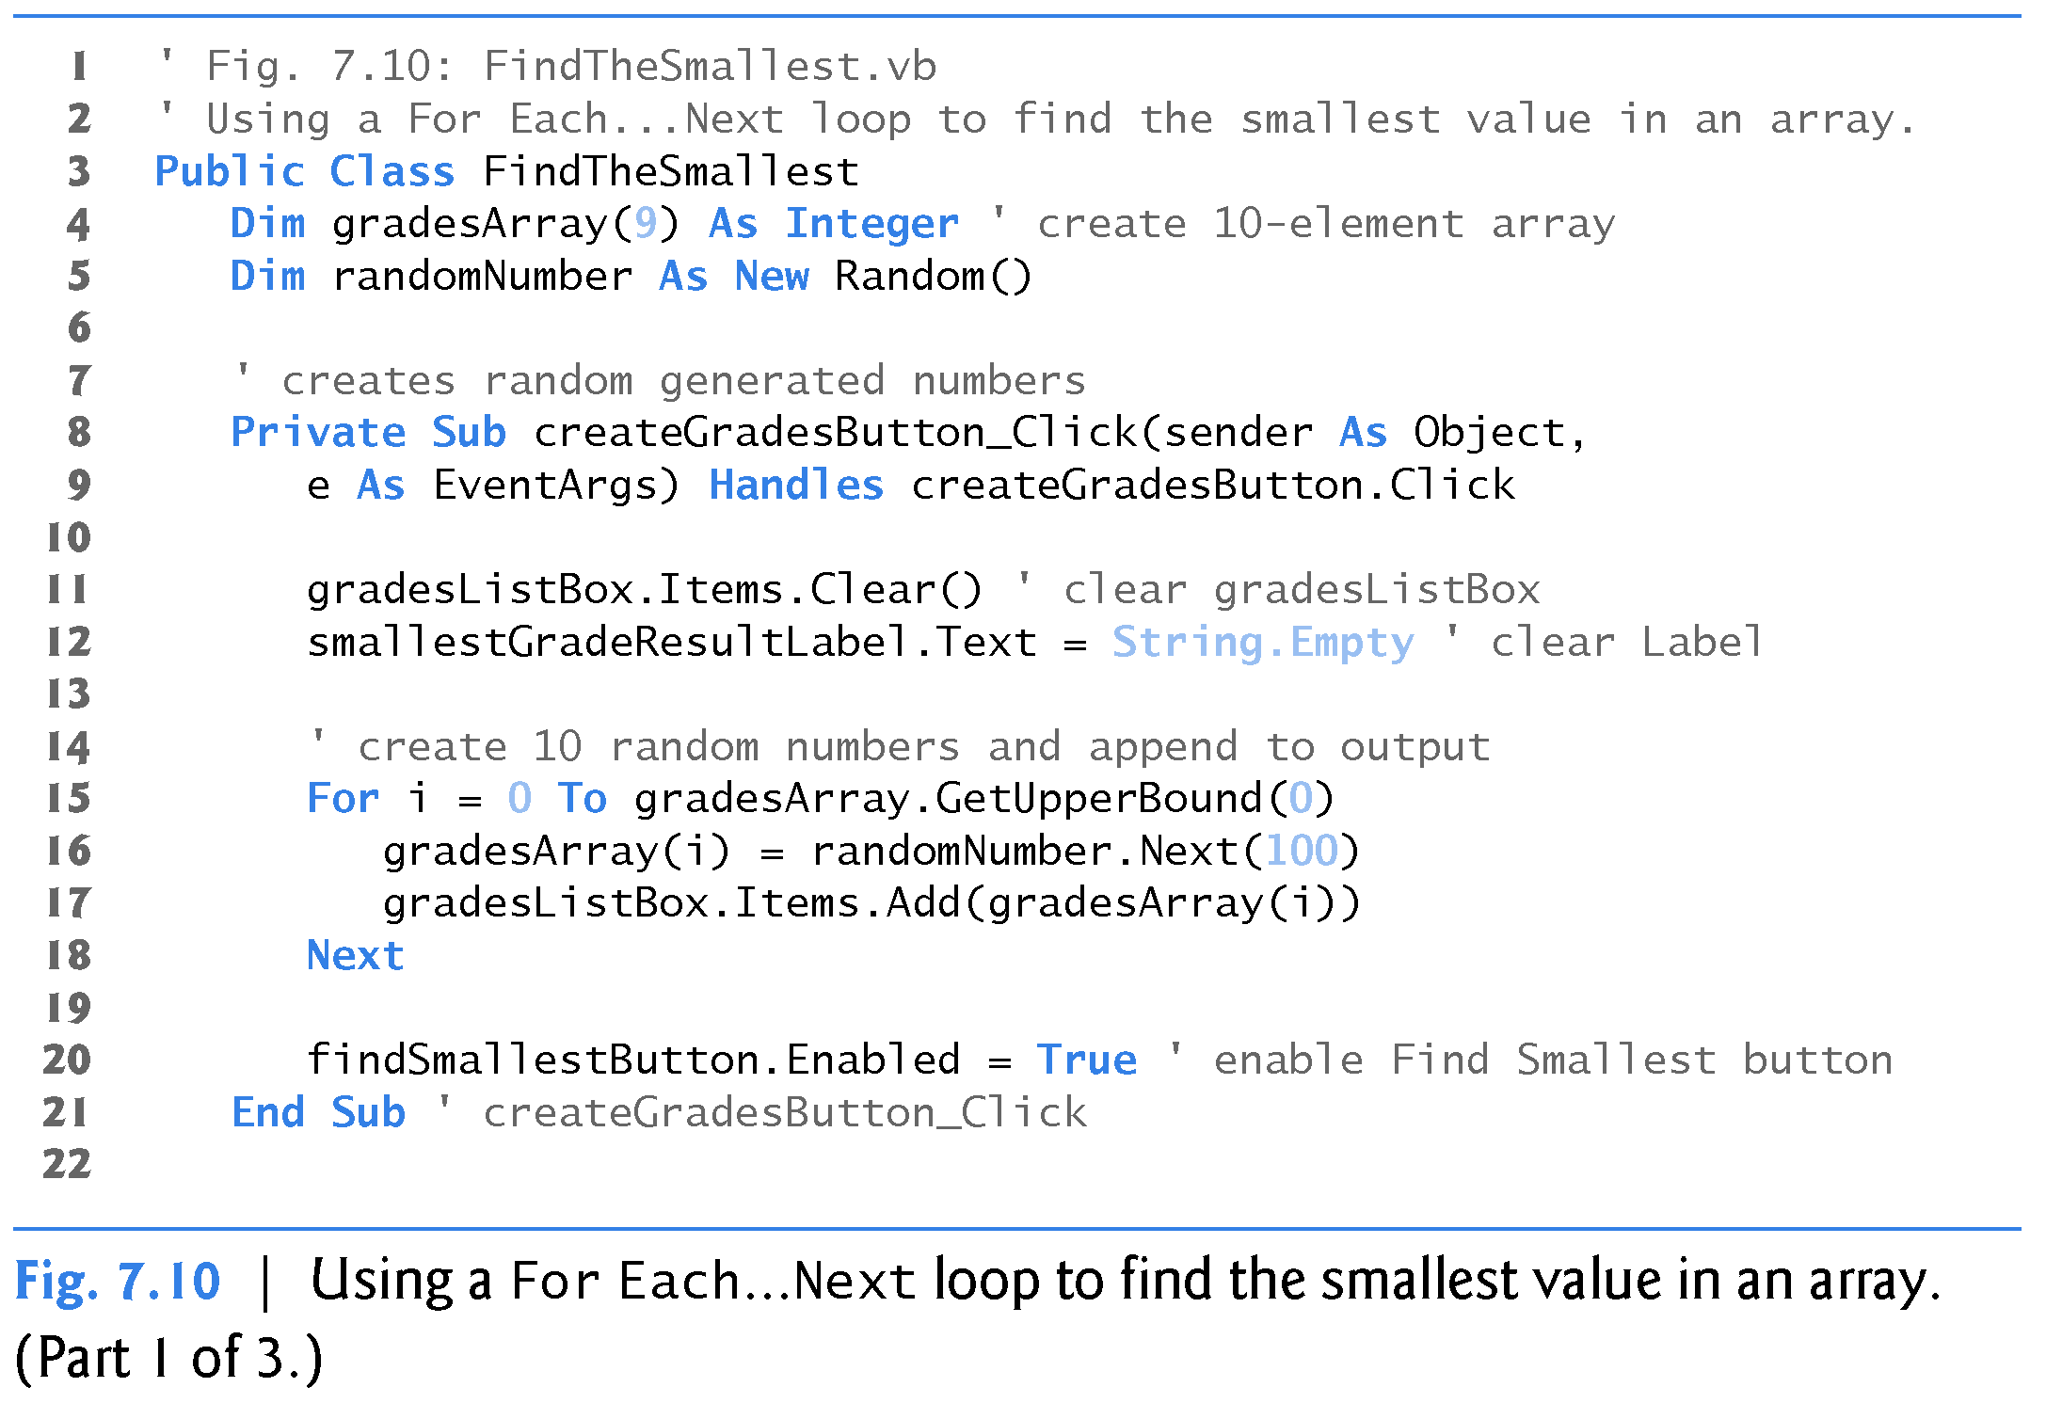
For Each…Next Statement (cont.)

Slide 21
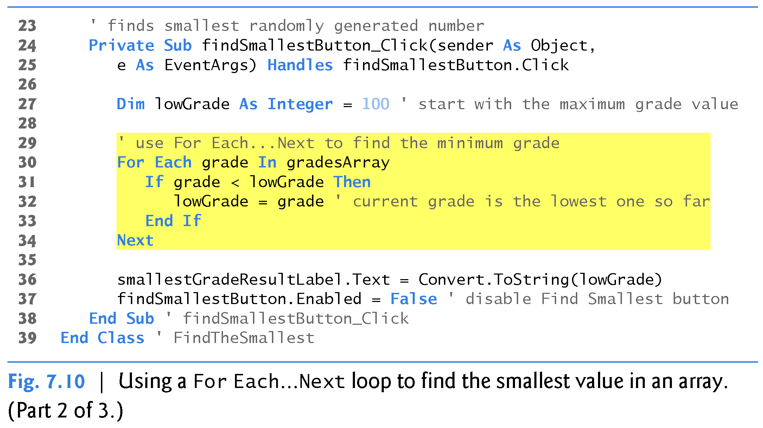
For Each…Next Statement (cont.)

Slide 22
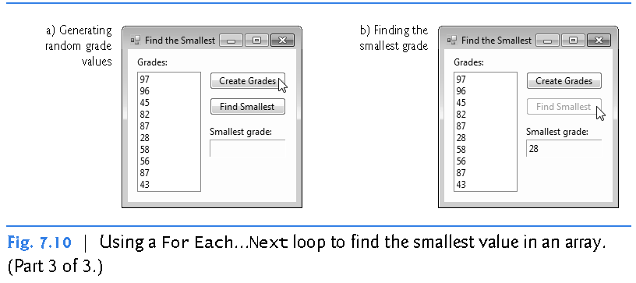
For Each…Next Statement (cont.)

Slide 23
For Each…Next Statement (cont.)
In the prior example, the type of variable grade is determined from the type of the elements in gradesArray
However, you can also declare the variable’s type explicitly as in
For Each grade As Integer In gradesArray
The For Each…Next statement iterates through all the elements in gradesArray, sequentially assigning each value to variable grade
  The values are compared to variable lowGrade, which stores the lowest grade in the array

Slide 24
Sorting Arrays
Sorting data (i.e., arranging the data in ascending or descending order) is one of the most popular computing apps
Examples
  A bank sorts all checks by account number, so that it can prepare individual bank statements at the end of each month
  Telephone companies sort their lists of accounts by last name and, within last-name listings, by first name, to make it easy to find phone numbers

Slide 25
Sorting Arrays (cont.)
Arrays have the methods and properties of class Array in namespace System
  Class Array provides methods for creating, modifying, sorting, and searching arrays
  By default, Array method Sort sorts the elements of an array in ascending order
To sort an array in descending order, first call method Sort to sort the array
  Then call Array.Reverse with the array as an argument to reverse the order of the elements in the array

Slide 26
Multidimensional Arrays
Multidimensional arrays require two or more indices to identify particular elements
We concentrate on two-dimensional arrays
  Also known as rectangular arrays
Two-dimensional arrays are often used to represent tables of values consisting of data arranged in rows and columns

Slide 27
Rectangular Arrays (cont.)
In a rectangular array, each row is the same size and each column is the same size
  Hence the term rectangular
To identify a particular array element, two indices need to be specified
  By convention, the first index identifies the element’s row and the second index the element’s column
A rectangular array with m rows and n columns is called an m-by-n array
  The array in Fig. 7.16 is a 3-by-4 array

Slide 28
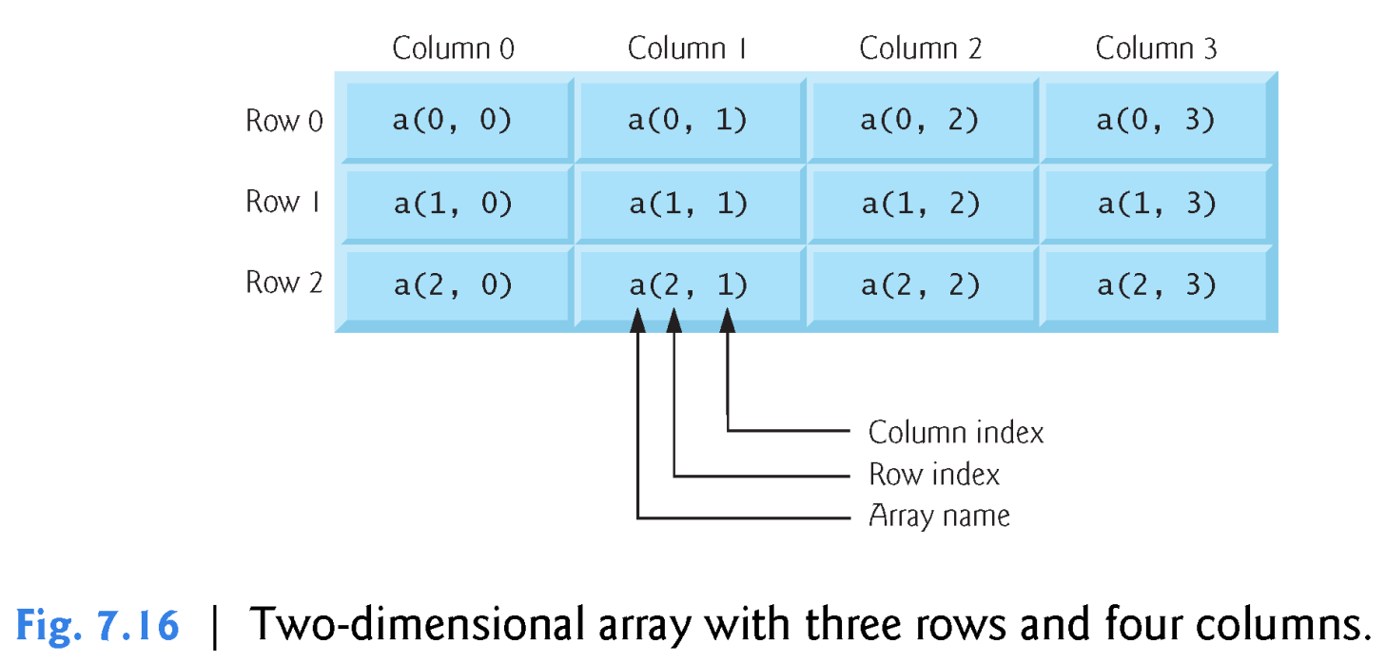
Rectangular Arrays (cont.)

Slide 29
Rectangular Arrays (cont.)
Declaring a Rectangular Array
A two-dimensional rectangular array numbers with two rows and two columns can be declared and initialized as follows
      ‘Numbers in a 2 by 2 array
      Dim numbers(1, 1) As Integer
      numbers(0, 0) = 1 ‘Leftmost element in row 0
      numbers(0, 1) = 2 ‘Rightmost element in row 0
      numbers(1, 0) = 3 ‘Leftmost element in row 1
      numbers(1, 1) = 4 ‘Rightmost element in row 1

Slide 30
Rectangular Arrays (cont.)
Declaring a Rectangular Array
Alternatively, the initialization can be written on one line, as shown with and without local type inference below
      Dim numbers = {{1, 2}, {3, 4}}
      OR
      Dim numbers(,) As Integer = {{1, 2}, {3, 4}}

Slide 31
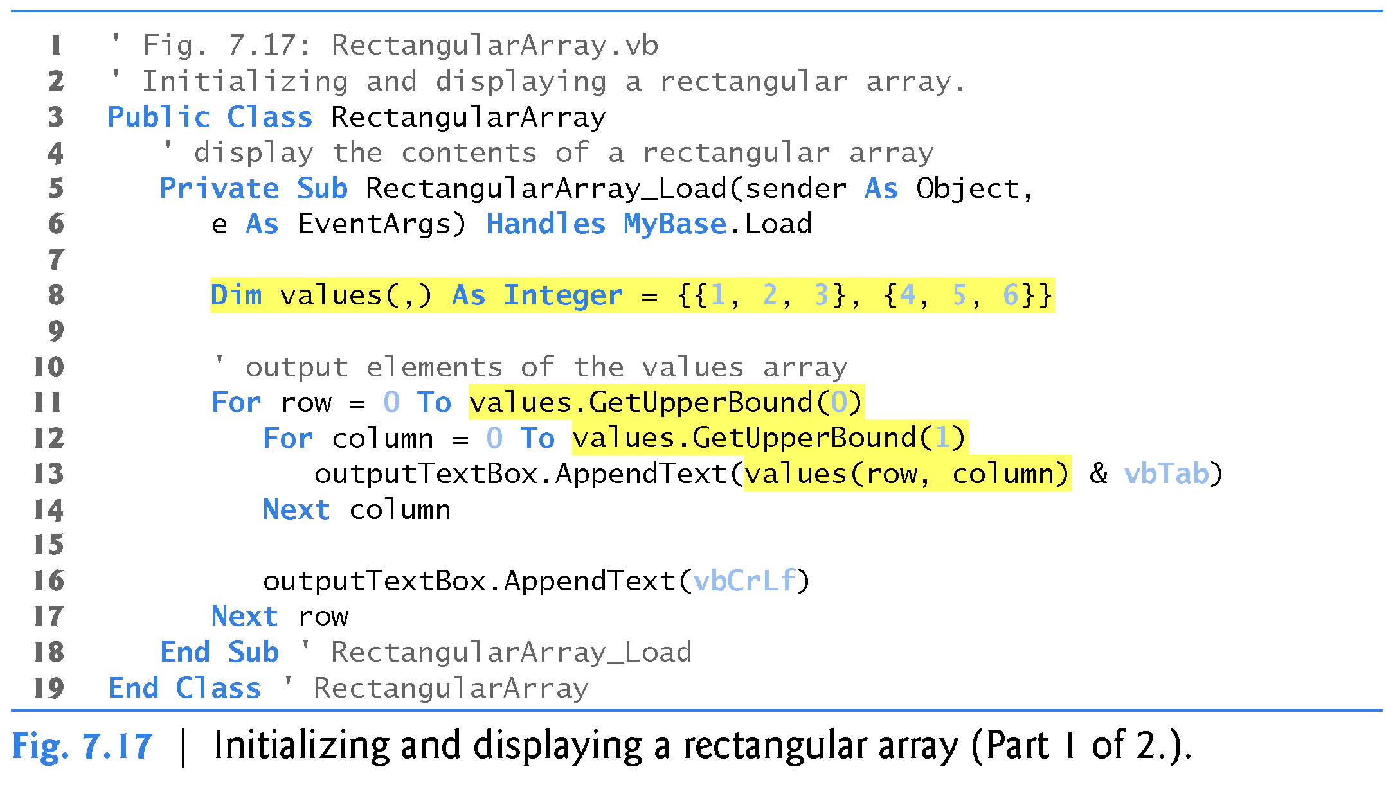
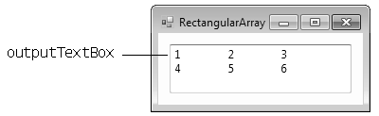
Rectangular Arrays (cont.)
Manipulating a Rectangular Array

Slide 32
Resizing Arrays
The size of an array cannot be changed
  Therefore, a new array must be created if you need to change the size of an existing array
The ReDim statement resizes an array at execution time by creating a new array and assigning it to the specified array variable
  The old array’s memory is eventually reclaimed by the runtime
To save the original data stored in an array, follow the ReDim keyword with the optional Preserve

Slide 33
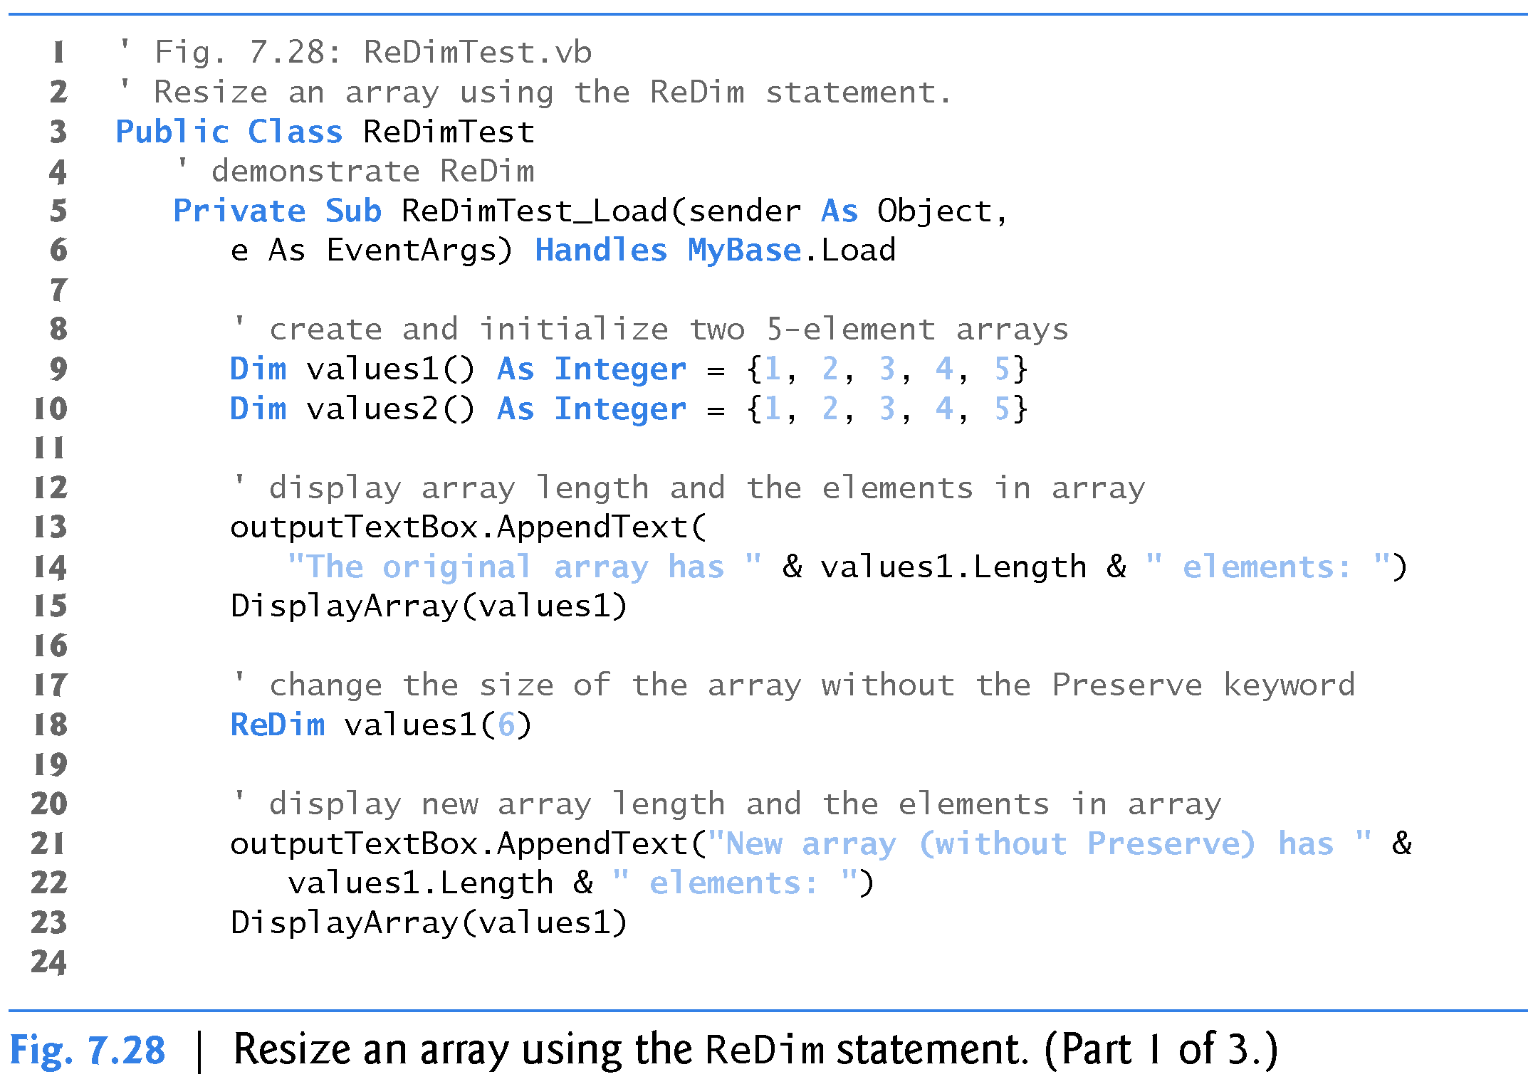
Resizing Arrays (cont.)

Slide 34
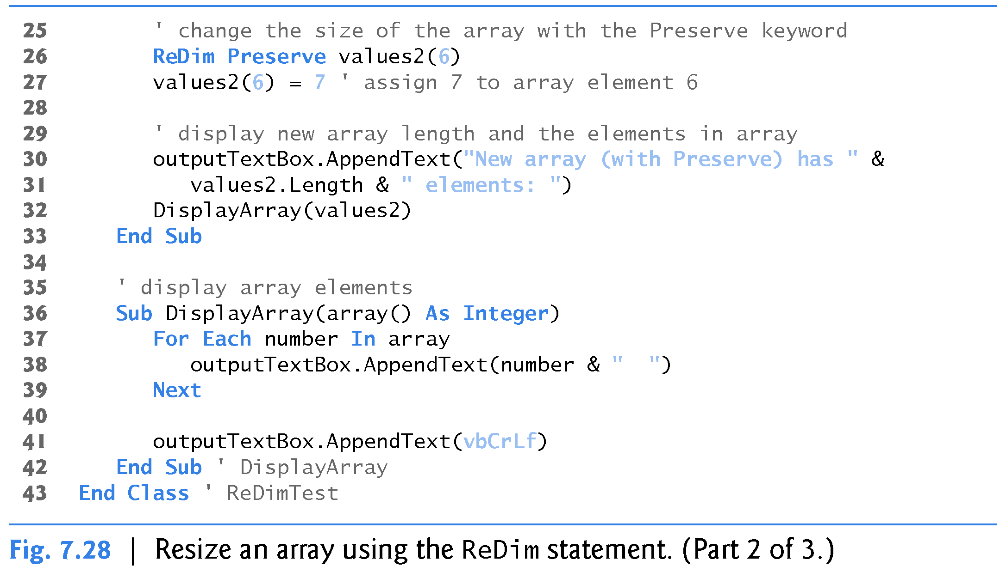
Resizing Arrays (cont.)

Slide 35
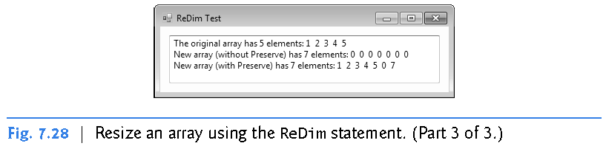
Resizing Arrays (cont.)

